Slide 1
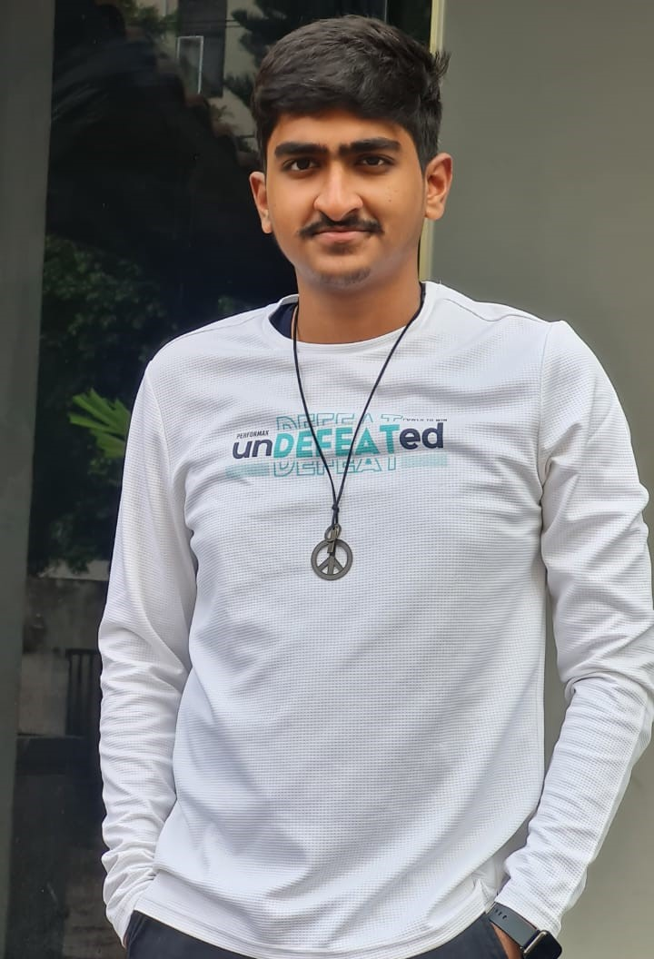
ADDALA AKASH VARMA
Project Engineer – Gen AI | Agentic AI | Machine Learning | Mern Stack Email : Addala.varma1@wipro.com
Phone : +91 – 8839353494
Summary
B.Tech Computer Science and Engineering graduate from Vellore Institute of Technology (CGPA 8.75) with strong industry focus on Generative AI and Agentic AI development, including RAG-based applications, autonomous decision-making agents, LLM integrations, and backend services using FastAPI and JWT-based security. Completed a Wipro capstone project to develop an Agentic AI solution for automated order management, demonstrating enterprise-scale workflow orchestration and AI-driven automation. Experienced in full-stack MERN development and machine learning projects such as Calories Burnt Prediction using XGBoost, with basic exposure to Databricks and PySpark, and certified in PL/SQL. Passionate about building scalable AI-driven solutions for real-world business problems.
Technical Skills
Generative AI & Agentic AI: RAG pipelines, multi-agent workflows, LLM integration, prompt engineering, tool/function calling, autonomous decision-making; developed Agentic AI capstone at Wipro for order management automation.
Backend & APIs: FastAPI, RESTful services, JWT authentication, microservices architecture
Full-Stack Development: MERN Stack (MongoDB, Express.js, React.js, Node.js)
Machine Learning: Regression models, XGBoost, feature engineering; built
Calories Burnt Prediction system
Data & Vector Systems: Vector databases, embedding pipelines, document ingestion, chunking strategies
Big Data (Basic): Databricks (basic), PySpark (basic)
Databases: SQL, PL/SQL (Certified), MongoDB
Programming: Python, Java, C++

Slide 2
Experience
Wipro, Chennai [Project Engineer – AI September 2025 – Current]
Projects
Agentic AI–Driven Order Management Automation (Capstone Project – Wipro)
Developing an Agentic AI solution to automate order lifecycle operations using
AutoGen-based multi-agent orchestration and LLM-driven decision making.
Designing collaborative agent workflows for order intake, validation, exception handling, and status resolution.
Implementing RAG pipelines over enterprise documents and order data for contextual reasoning.
Building backend services and APIs using FastAPI for agent coordination and enterprise system integration.
Integrating vector databases for document ingestion, embedding generation, and semantic search.
Conversation-to-Audio Generator — Wipro Hackathon Winner
Built a full-stack application that converts multi-speaker conversations from Word documents into realistic audio dialogues with selectable gender and accent.
Implemented backend services using Python and FastAPI, document parsing via
python-docx, and speech synthesis with Coqui TTS.
Assembled multi-speaker audio streams using pydub and exposed REST APIs through Uvicorn.
Deployed the service to generate shareable links for Microsoft Teams collaboration.
Won Wipro’s internal hackathon for delivering a practical, AI-driven automation solution.
RAG-Based Knowledge Assistant (WEGA – Wipro)
Migrated a RAG-based document chat application to Wipro’s internal WEGA platform.
Built document ingestion pipelines including parsing, chunking, embeddings, and vector database storage.
Improved retrieval accuracy through semantic chunking and metadata tagging.
Integrated enterprise LLM services and validated chatbot responses.
Designed query-time retrieval and prompt construction workflows for grounded answers.

Slide 3
Implemented document versioning and incremental update handling in the vector store.
Conducted accuracy and latency benchmarking against the legacy platform.
Followed enterprise security and access-control standards for document-based AI systems.
Education
Bachelor of Technology in Computer Science and Engineering
Vellore Institute of Technology (VIT), Vellore | CGPA: 8.75
Senior Secondary (12th Grade) – DAV Public School, CBSE | Percentage: 89.4% Secondary (10th Grade) – DAV Public School, CBSE | Percentage: 87.8%
Certifications
Agentic Ai by Wipro
Generative Ai by Wipro
Github Copilot by Wipro
Databricks in Udemy
PySpark By Wipro
GCP By google
PL/SQL (Myskillz)
Google Cloud Computing Foundation Program (Google)
C++ Advanced Coding Course (Coding ninjas)
Mern stack (Ethunus)
Awards
Wipro Hackathon Winner – Developed Conversation-to-Audio Generator converting multi-speaker conversations into realistic audio with selectable accents and gender.
Patient-Centric Recognition – Contributed to FortiChat final-year project, focusing on real-time detection and automation for network security and patient-related alerts.

